Slide 1

Traffic Violation Detection Application Using Video Footage
Prageeth Godage ( MSC/DSA/098)

Slide 2
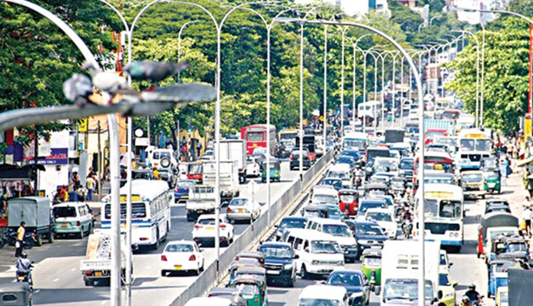
Introduction
Traffic rules are set by government regulatory entities to ensure the safety of road users, drivers, public property.
Traffic rules are established by government regulatory entities to ensure road safety for all users. However, frequent violations result in significant harm to individuals and public property
Due to various factors, such as driving behaviors and poor road conditions, these violations are increasing rapidly, making it challenging for the police department to enforce the rules effectively.

Slide 3

PROBLEM STATEMENT
Recently, the police department implemented software to involve public support in addressing traffic violations.
Citizens can upload footage of violations directly to the police department.
However, processing large volumes of traffic violation video footage manually is challenging.
Our plan is to extract actionable information from video footage via deep learning technologies.

Slide 4
Potential solution
We aim to address this issue by accurately detecting traffic violations using video footage.
These results will support downstream analysis and enforcement
However, due to time and data collection constraints, we aim to address the solution to some extent in this research

Slide 5

challenges
The primary challenge is the lack of sufficient training data. We plan to address this using the following prioritized strategies
Strategy 01: Collation of data by collaborating with the police department.
Strategy 02: Collecting data from our own footage with the necessary approval from the traffic police.
Strategy 03: Simulating and collecting data in a controlled environment.
Strategy 04: Using benchmark datasets.
Another challenge is the time constraint:
Focusing on a selected set of violations to address

Slide 6
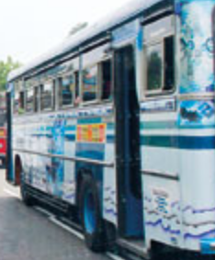
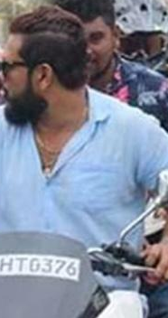
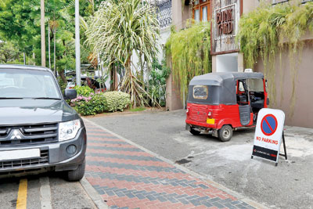
Scope of the work (Tentative)
We initially planned to detect the following violations:
Detecting violations of illegal lane crossing of vehicle.
Detecting riders not wearing helmets.
Detecting illegal parking.
Detecting vehicles turning at junctions without using signal lights.
However, this is not finalized list and will depend on the timeline and data collection strategy.

Slide 7
High-Level Execution Plan
Conduct a literature review
Collect data based on the discussed strategy.
Adjust the scope based on data collection and timeline.
Convention ML model building (Preprocessing, Model selection, Training and Evaluation…).
Future development.

Slide 8

Future developments
This project has ample room for future development. If time permits and other factors align, we plan to add more features to the application.
Widen the violation detection rules.
Enhance detection accuracy.
Explore additional integration options.
Implement batch processing through cloud deployment
Mobile deployment(have some dependency ML model capable of deploy on mobile)

Slide 9
Thank you.
Questions and Discussions

